Slide 1
NGO Presentation
Lujia Deng, Masha Gubenko, Luwei Lei, Miao Wang

Slide 2
Table of Contents
Problem Statement
Data Overview
Methodologies
T-test
PCA
Random Forest
Future Works

Slide 3
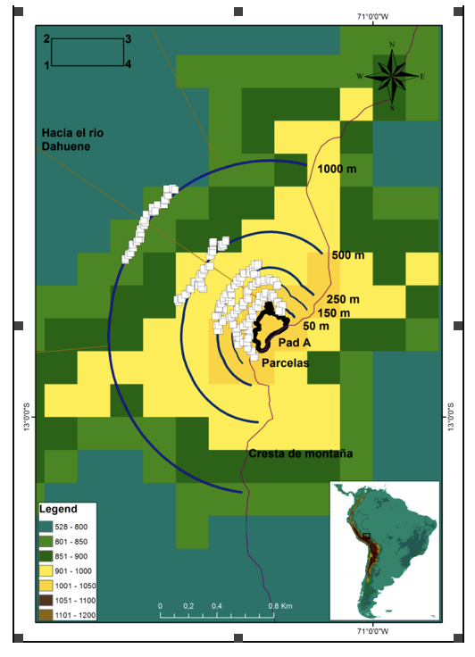
Background & Objective
Varied responses to impacts of natural gas exploration by an amphibian assemblage in a pre-montane Amazonian forest in Peru
Goal:
Does amphibian
1) species composition,
2) abundance of individuals and
3) size distribution of individuals
change with distance from the platform and phase of construction/operation of the gas drilling well?

Slide 4
Data Overview
op data anal - Morona BMAP.xlsx
Fecha: date
Phase:
EC: early construction
LC: late construction
DR: during drilling
RI: reinjection
AB: abandon
People in PAD: # of people at camp
Hours worked: # of hours worked
# Operational Equipment: # of heavy machines
N° Horas de impacto de lluvia: # time of rain, no human activity, less noise
Fuel use: fuel use (value may be inaccurate at early stages)
N° de vuelos de helicoptero: # of helicopters, loud noise
raw data for Andres - Morona BMAP.xlsx
Environmental data from 2014 ~ 2016
Composition sheet variables:
Hora Inicio: start time
Hora Final: end time
Hora del encuentro: time of encounter
Percha (m): location (high/low)
Percha tipo: location type (eg. on the floor, in the tree, etc.)
Comportamiento: behavior
Masa (g): mass
SVL (mm): length from nose to vent
Cola (mm): tail length
Codigo foto: photo code
Codigo voucher: whether captured

Slide 5
Data Preprocessing
Spanish attributes → English attributes
Merged three datasets
Dates format
Columns
NaN columns
S_hour / S_people
Lat & Long

Slide 6
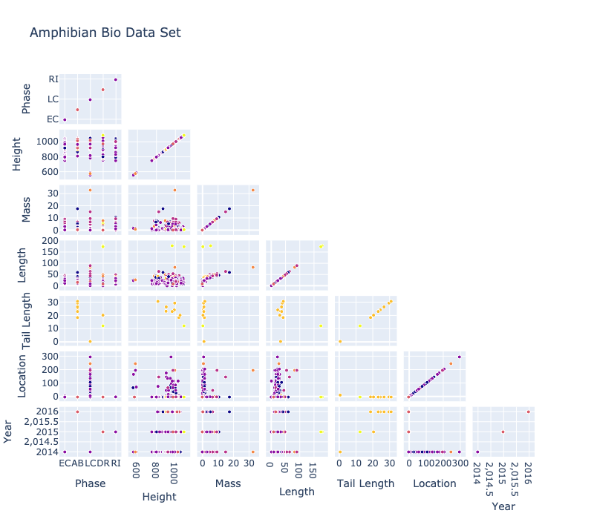
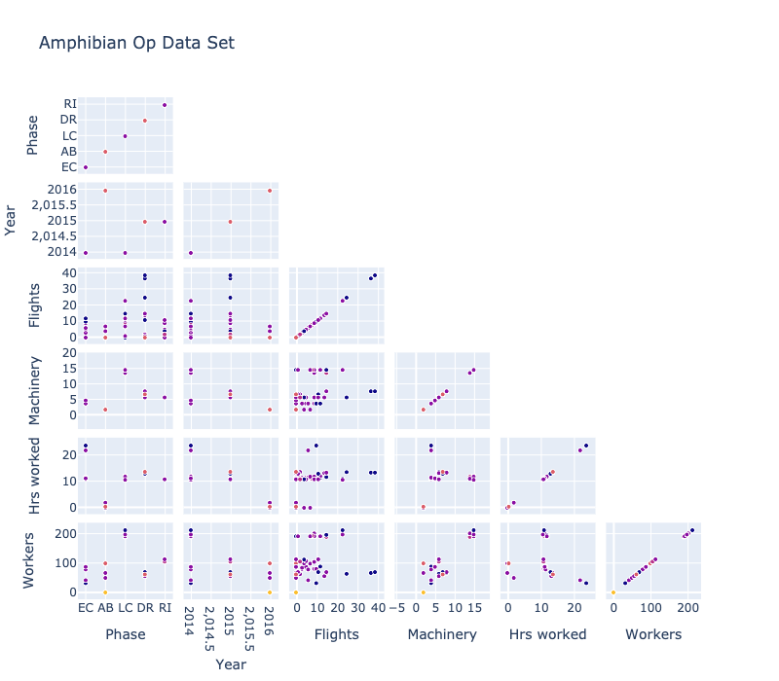
Data Overview
Positive correlation between a number of attributes

Slide 7
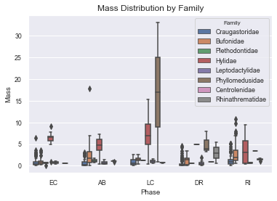
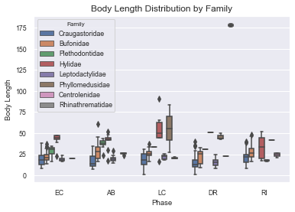
Data Overview (Cont’d)
Most variance in body length and mass during late construction

Slide 8
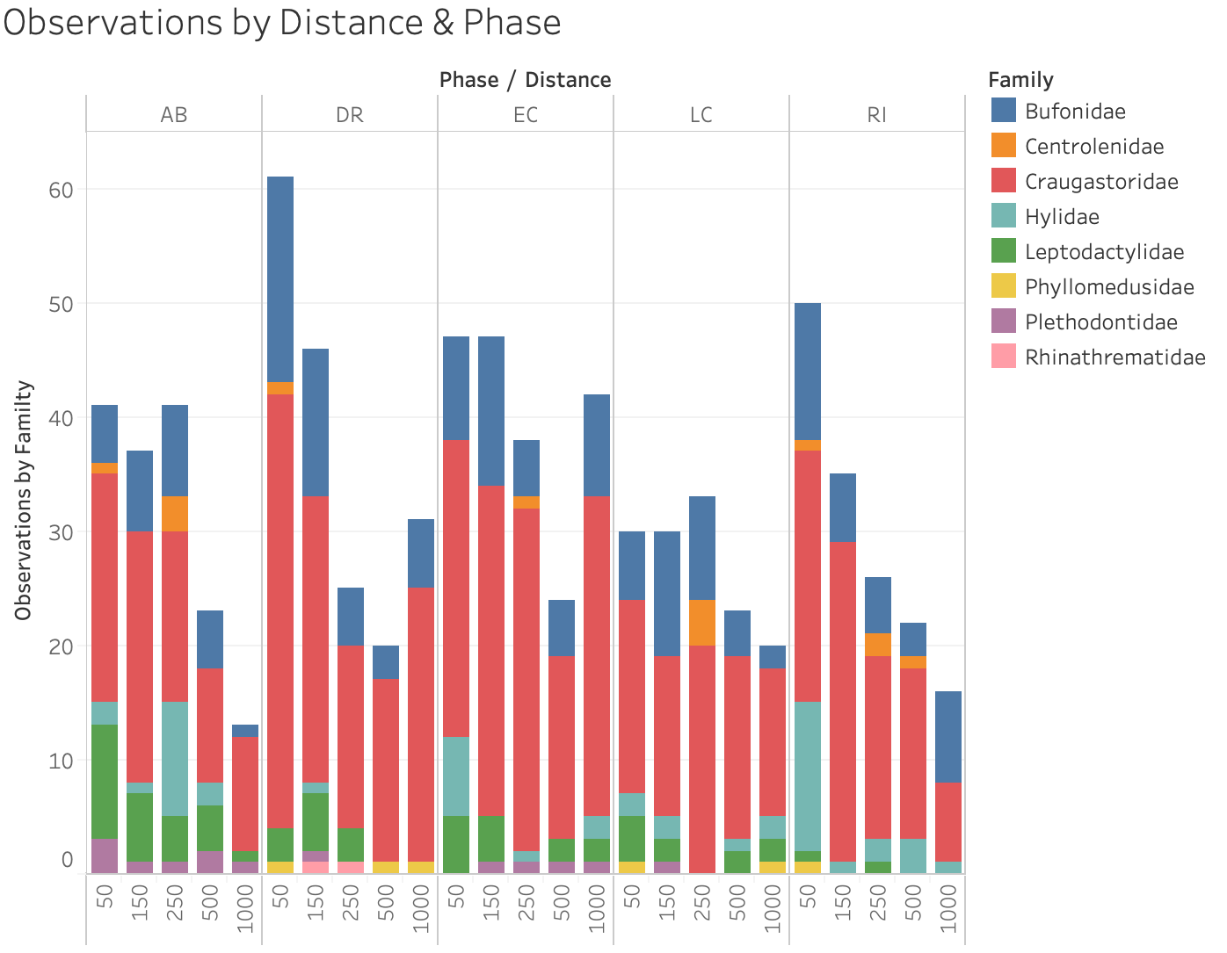
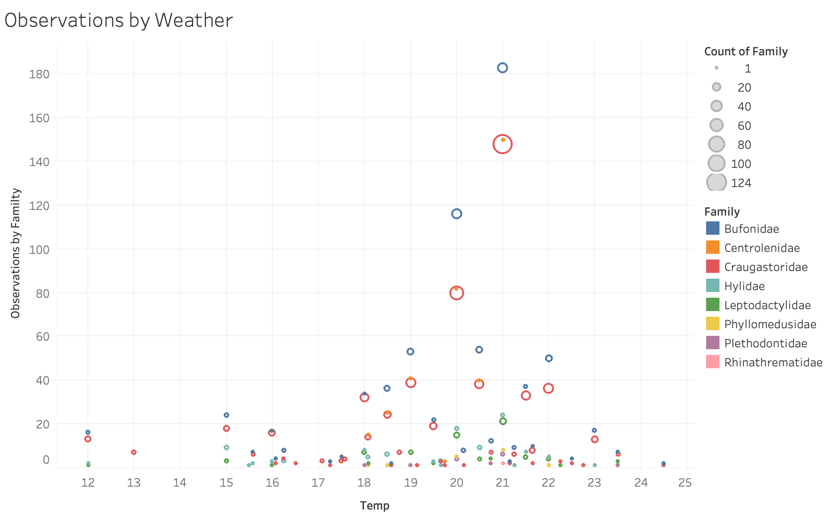
Data Overview (Cont’d)

Slide 9
T test
Features
Family
Mass
Body length
Distance (location)
Hypothesis:Is there any change for the species’ biological information in different phases (overall species or by family)?

Slide 10
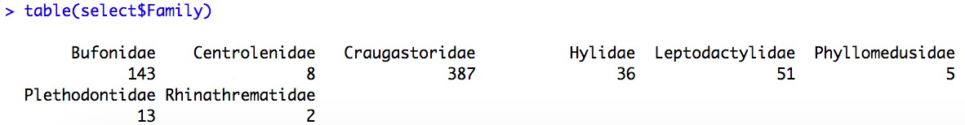
T test
Phase
Abandonment
Early Construction
Non-abandonment (Early Construction+Drilling)
Comparison:
Abandonment vs Non-abandonment (overall & by families)
Abandonment vs Early Construction (overall & by families)

Slide 11
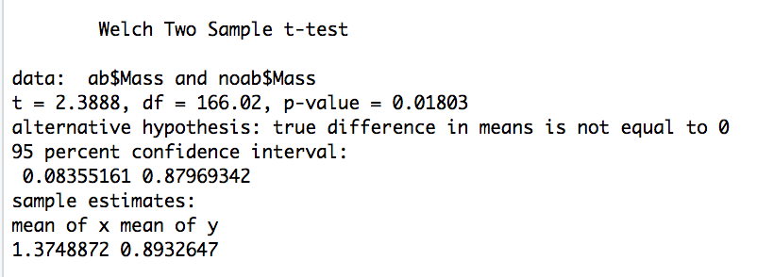
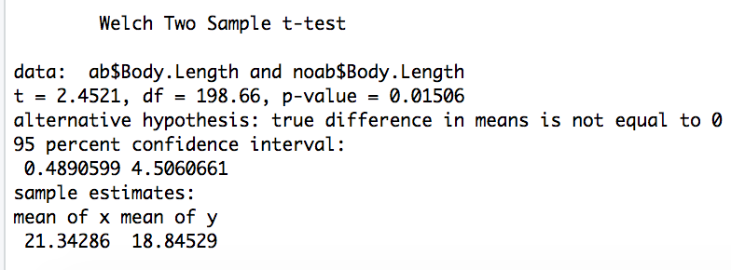

Slide 12
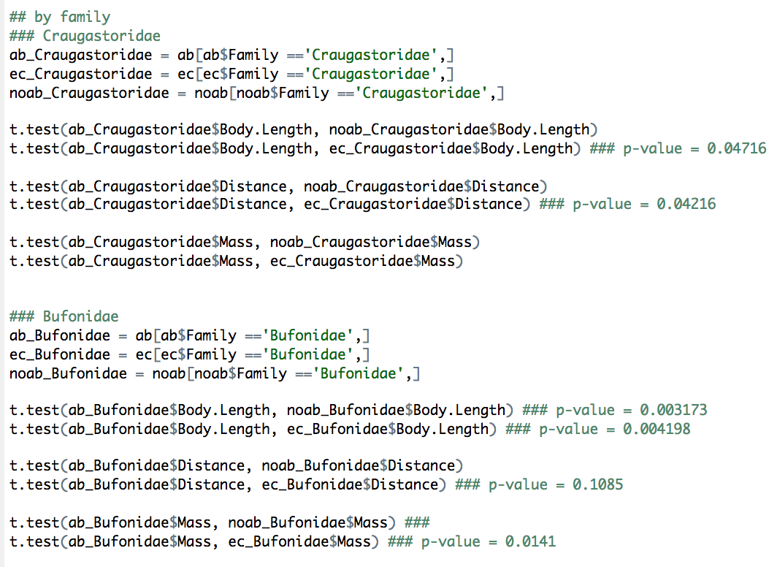
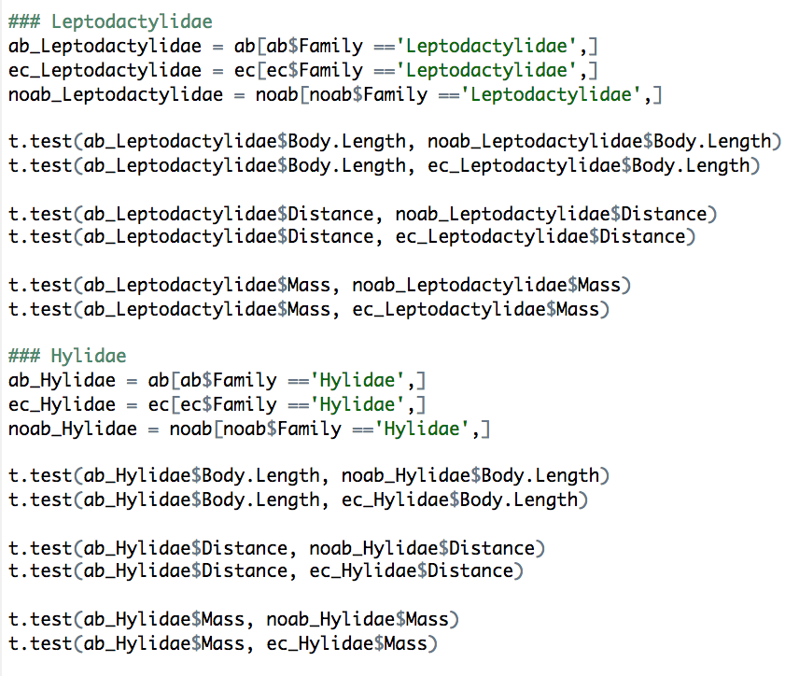

Slide 13
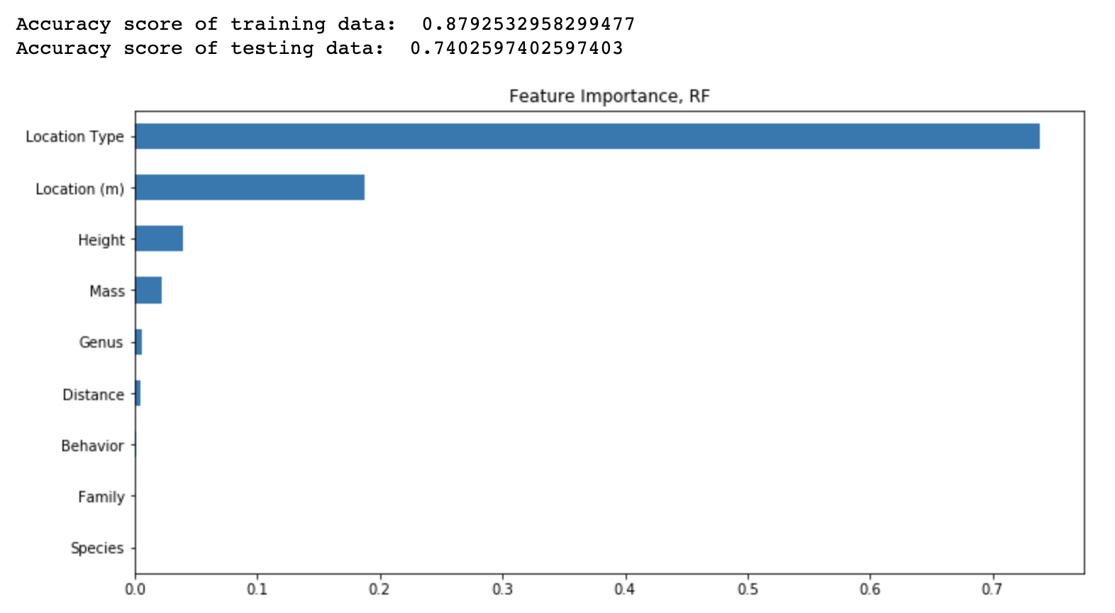
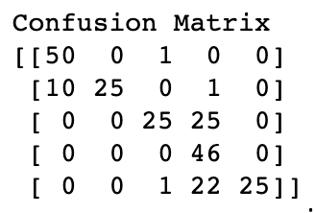
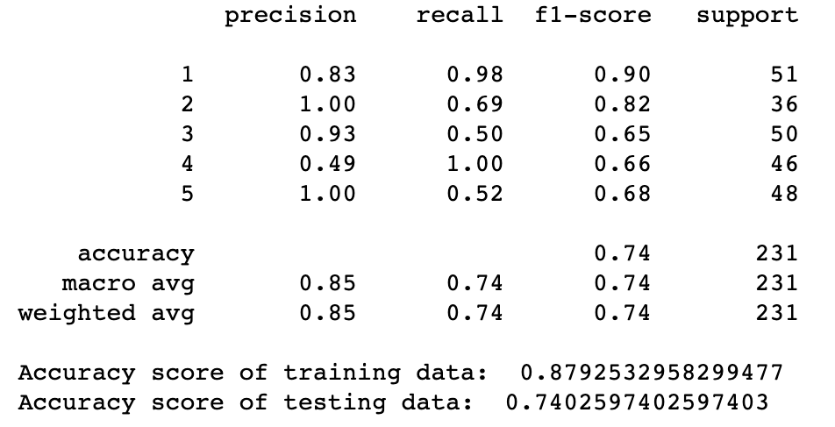
Random Forest
Phase 1, 3, 5, 4, 2
Notes:
if the prediction accuracy is high, it means the features we used for prediction actually has a strong correlation with construction phase

Slide 14
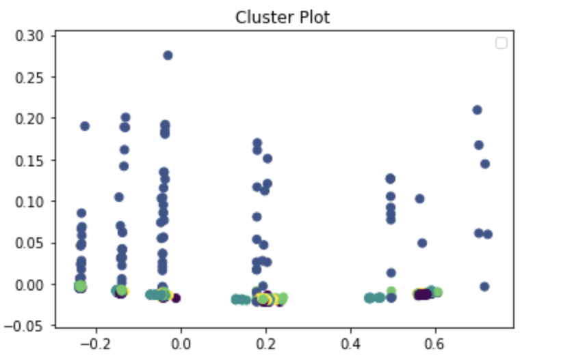
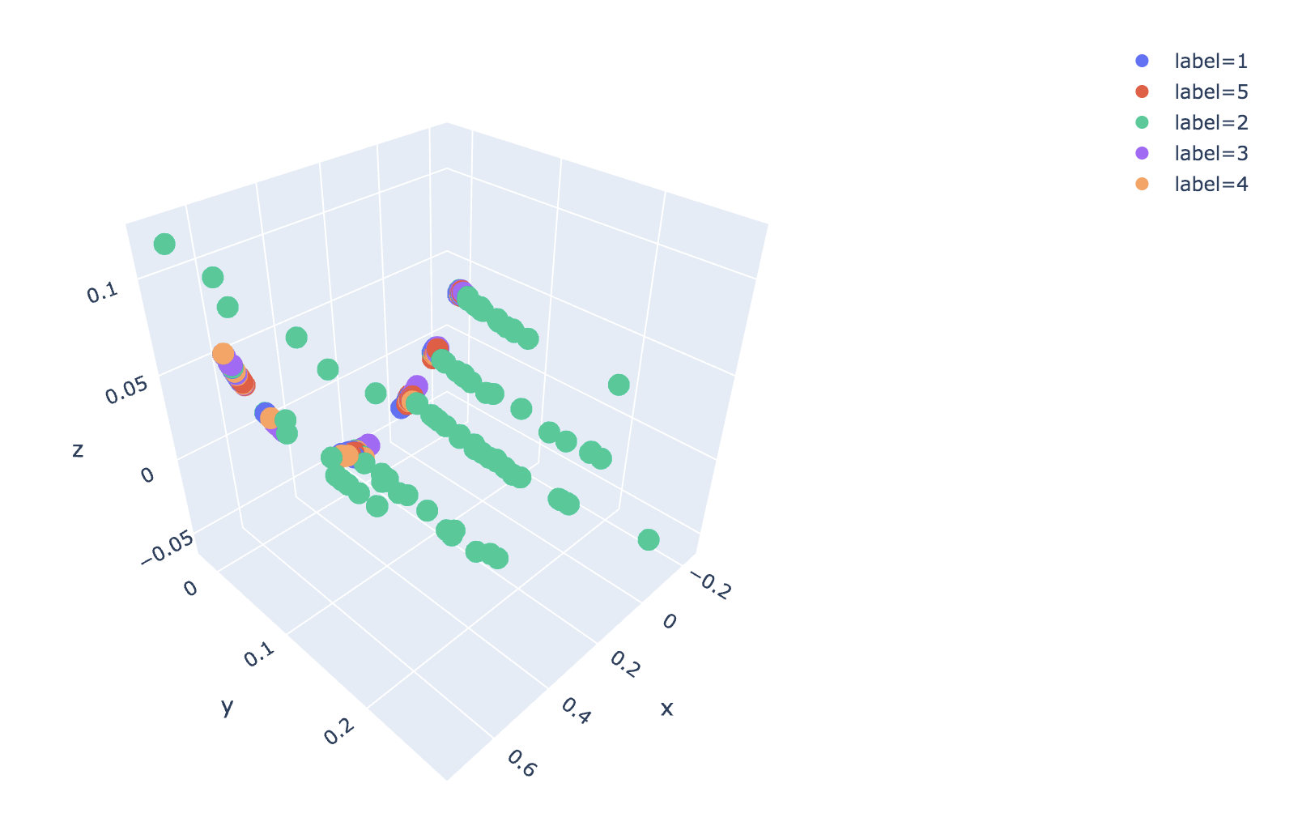
PCA

Slide 15
Future Works
Occupancy Model
Geo heatmap

